Slide 1
Employee Attrition Analysis at Company A
Max Moro and Shane Weinstock

Slide 2
Response and Scenario
Company A has experienced and recorded attrition information in regards to it’s workforce. The data that is available to us covers the period of 2010 through 2019.
We will mostly be focused on the attrition rate for our single variable analysis and initial studies of this data. As we become more advanced with our techniques, we plan to analyze other variables in accordance with the attrition rate.
Some of the other variables of interest are:
Age of employee
Tenure at Company A
Satisfaction
Annual performance ratings
Salary
Monetary recognitions (bonuses)

Slide 3
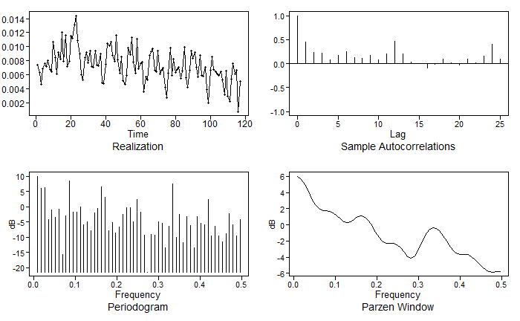
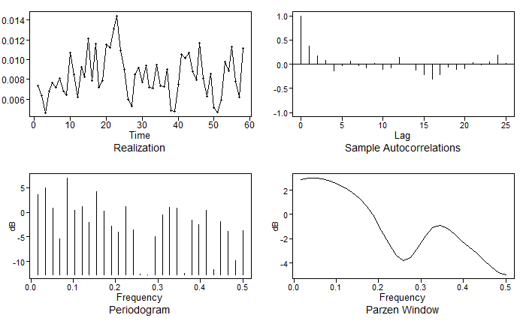
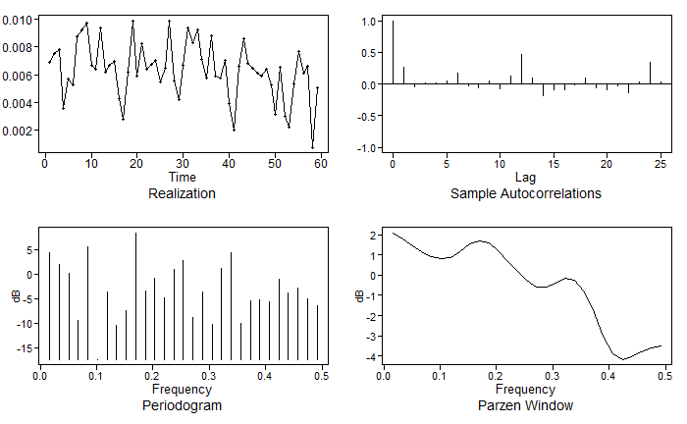

Fitted Models
Realization of Full Dataset
Realization of First Half
Realization of Second Half
Condition 1 and 2 for stationarity were not met as our mean and variance depend on time.
And condition 3 not met as our ACF depends on time (as shown above).
The ACFs show quasi-cyclic behavior with some seasonality present.
Our Parzen Windows show peaks at frequencies of .71 and .34, approximately 3 and 6 months
Factor tables indicate that factors of s = 3 are present.
We also observed that the following factors were present:
They appeared in our data more specifically as:
Notes:
Mention conditions and note frequencies for transformation.

Slide 4
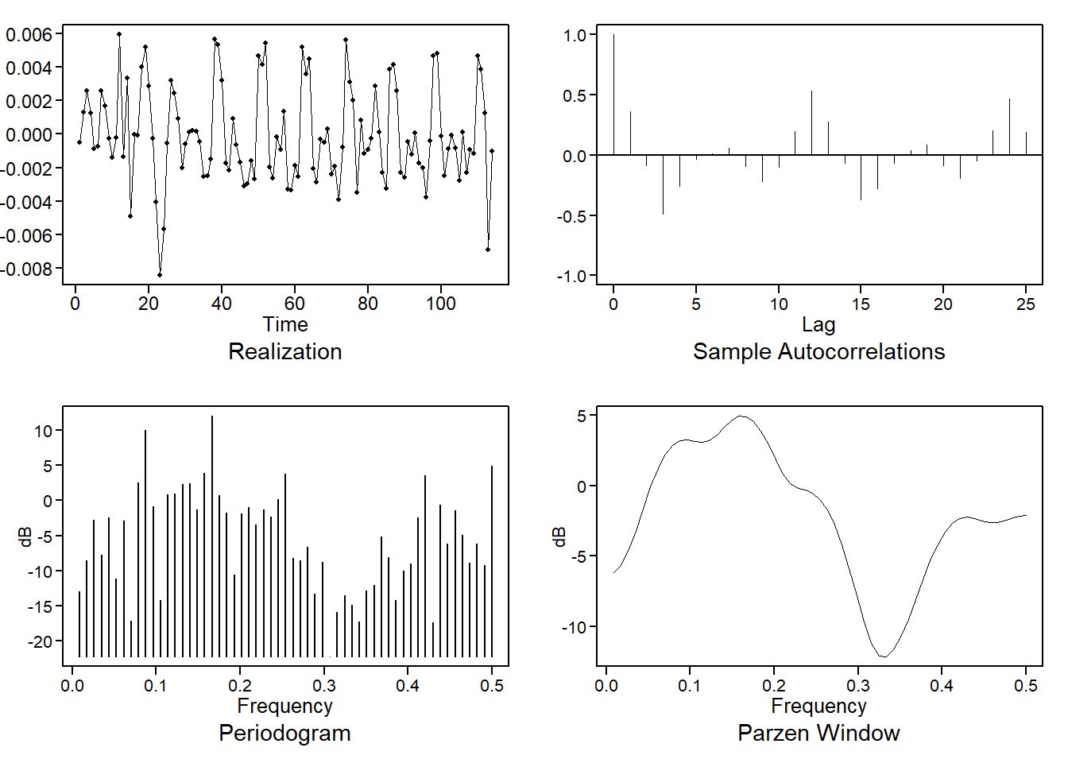
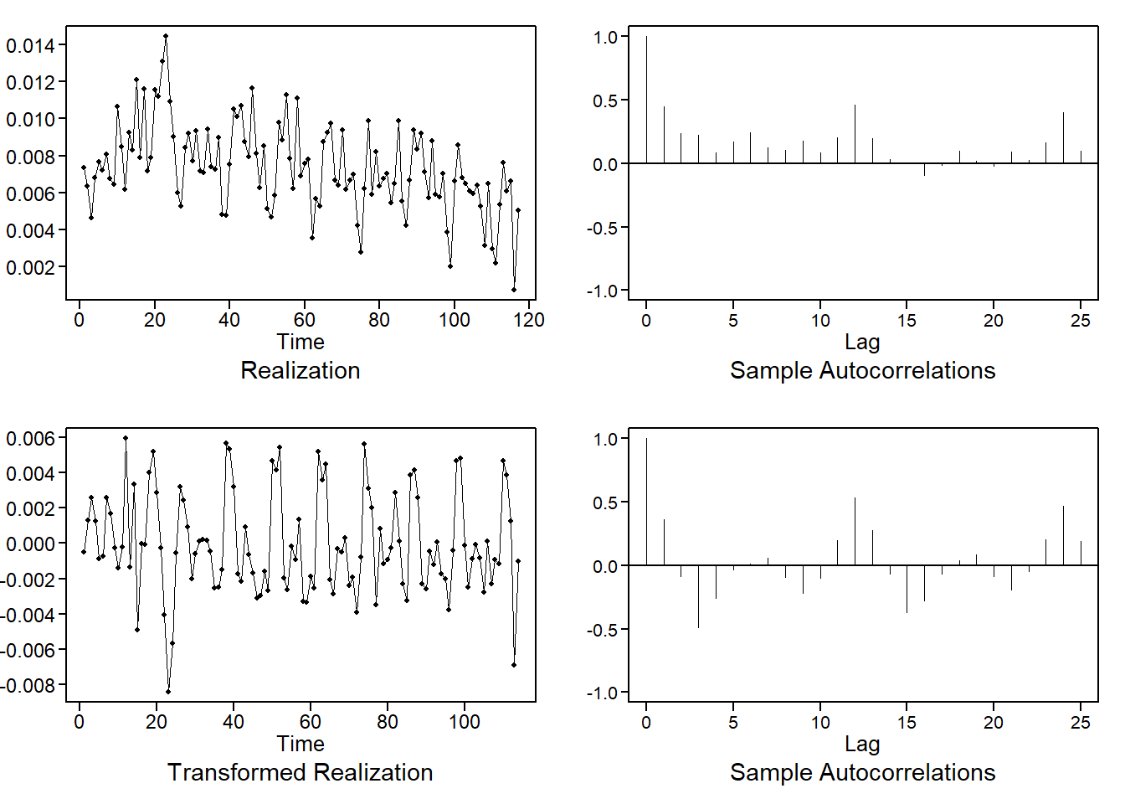
Fitted Models Cont.
Before continuing, we removed the s = 3 seasonality from the data.
Above are the new plots with the adjusted frequency after the transformation.

Slide 5
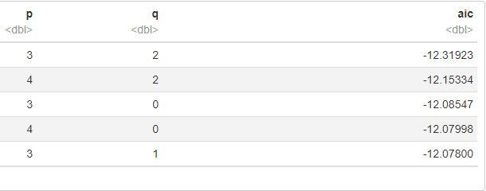
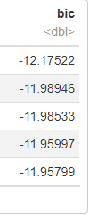
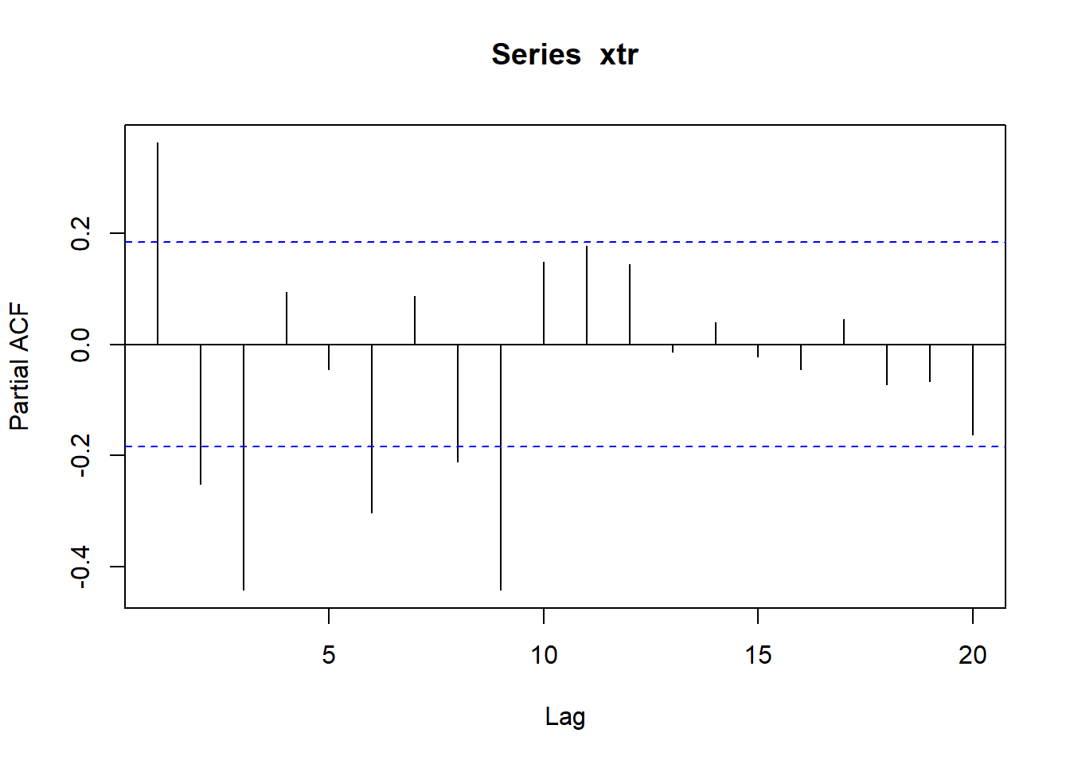
Fitted Models Cont.
Between our plots and the PACF, we notice that there are erratic patterns up to AR(9), likely indicating that this is not a pure AR model.
Sample autocorrelations continue to portray a sinusoidal pattern past .5, which notions us against a pure MA model.
AIC5 returns an ARMA(3,2) and an ARMA(4,2). And thus, with our evidence, that is what we’ve proceeded to our final model with.
Notes:
Main Takeaway: AIC5 returned the ARMA(3,2) and ARMA(4,2) and with these we proceeded to our final models.

Slide 6

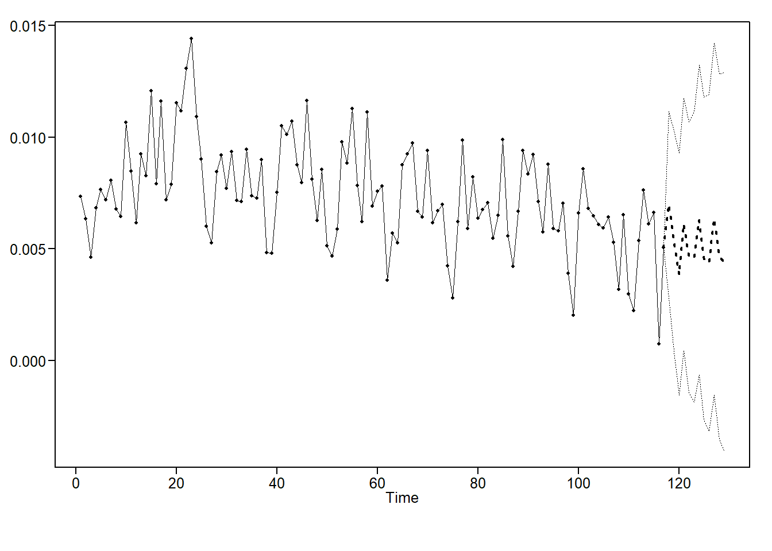
Model 1
ARMA(3,2) with s = 3
The model above is depicted in the graph to the left.
The graph left shows predictions 12 months into the future based off the model above.
ASE = 6.23269168316517e-06

Slide 7

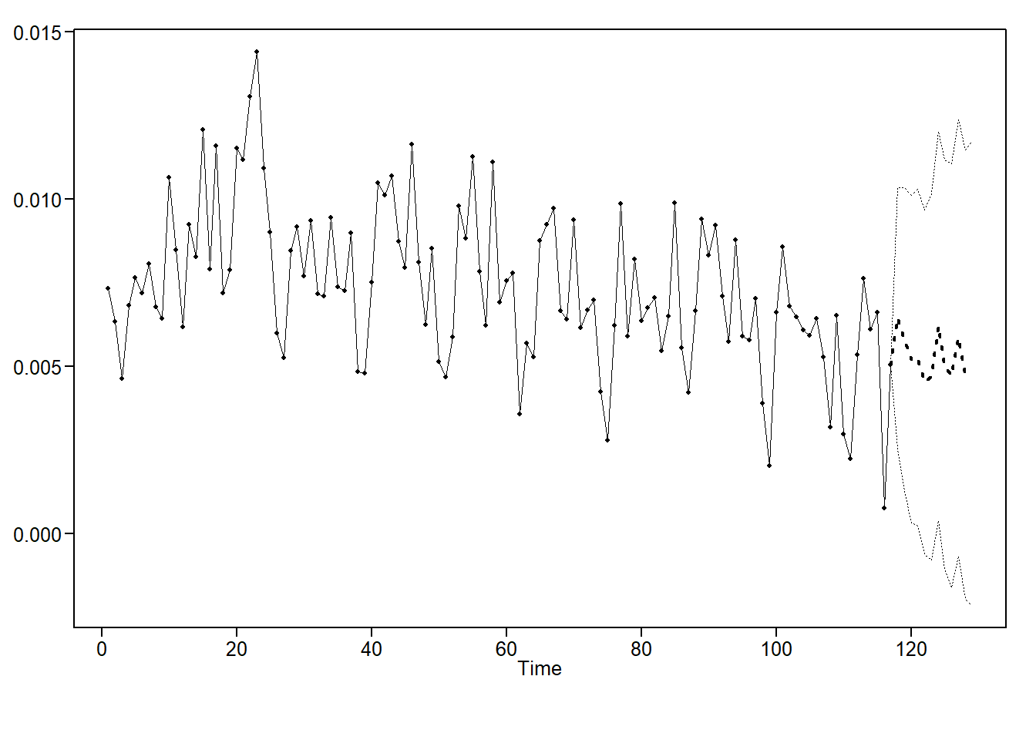
Model 2
ARMA(4,2) with s = 3
The model above is depicted in the graph to the left.
The graph left shows predictions 12 months into the future based off the model above.
ASE = 6.79168008564428e-06

Slide 8
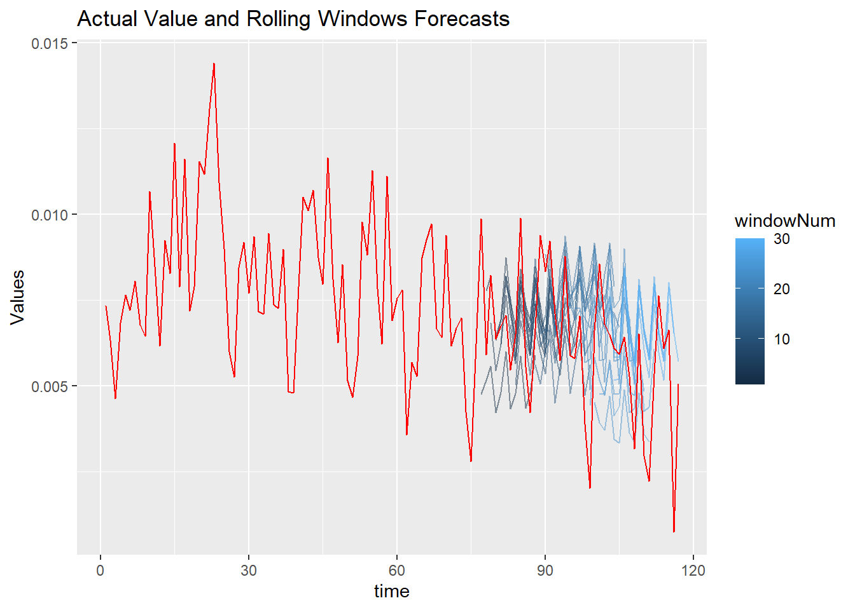
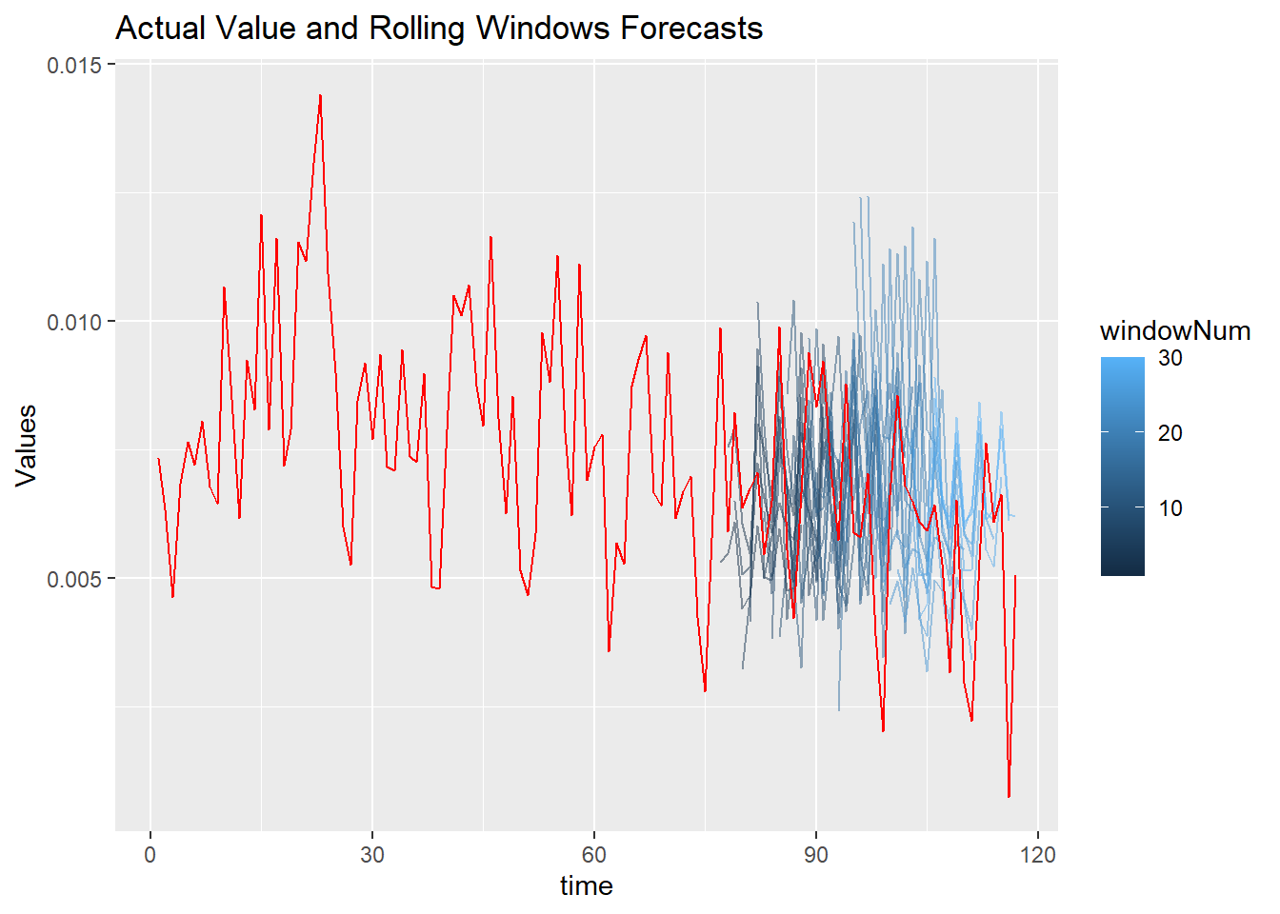
Compare the ASE // Models
Model 1
Between our two models we returned very similar values for ASE.
The 1st model (ARMA(3,2)) possessed a better moving window ASE than the our 2nd model.
The first model gives us a better expectation from month to month.
For our purposes, we would choose Model 1 for our final analysis at this time.
Model 2
Notes:
Speak to ASE values
Chose first model as it has better moving window
It also gives us a better expectation month to month
Overall both models could be useful

Slide 9
Our Strategy and Plan for the remaining Analysis.
It is clear that there are many variables that could have influenced the attrition Company A experiences.
We would like to include some of those variables to better predict the months and amount of employees leaving Company A throughout the year.
We may also be able to decipher the factors that are most important to employees whom are voluntarily leaving Company A.
Overall, the plan is to integrate and interpret additional variables and factors that may help us formulate a better prediction for Company A.

